Slide 1



Slide 2
Hybridization and Blotting Techniques
Prepared by
Dr Shuzan Ali Mohammed

Slide 3
Hybridization
It is the process of base-pairing between two complementary polynucleotide chains (ssDNA or RNA), of the same or different origins or length..

Slide 4
Hybridization can take place between:
*DNA chains.
* RNA chains.
* DNA-RNA combination
It can measure:
1- Maximum amount of polynucleotides hybridized
2- The rates of hybridization.

Slide 5
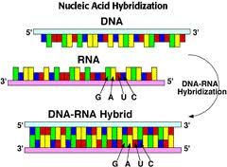

Slide 6
Uses of Hybridization: it determines
1. Certain sequence occurs or not in DNA of particular organism.
2. Genetic relatedness between different organisms.
3. Number of genes transcribed in particular mRNA.
4. Location of any given DNA sequence by annealing with a complementary probe.

Slide 7
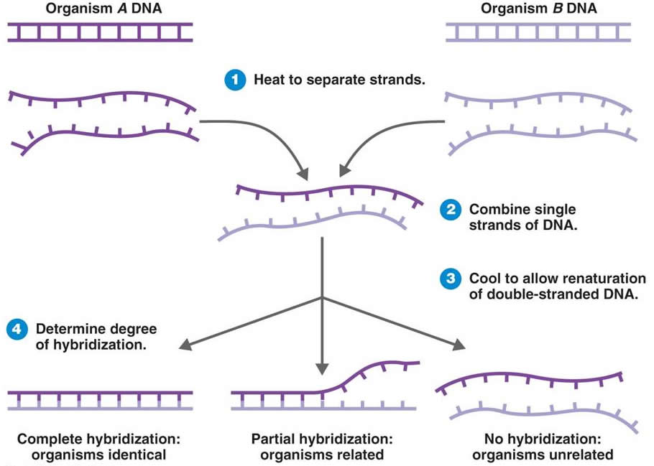

Slide 8
Probing DNA
Probe is a single stranded DNA or RNA
Of complementary sequence to that of DNA or RNA of interest
Labeled with radioisotope, fluorescent material or enzyme (e.g. alkaline phosphatase).

Slide 9
Probing DNA
DNA isolation
Digestion by restriction enzyme,
Separation on agarose gel (molecular weight).
Transfer of separated DNA fragments to appropriate filter by Southern technique
Hybridization with sequence specific DNA probe

Slide 10
During hybridization, only the probe molecules are attached to targeted DNA.
After hybridization, the filter paper is washed and subjected to autoradiography.
Bands visible on autoradiogram are characteristic for restriction enzyme and molecular probe used.
The location of bands depends on the size of fragments hybridized to the probe.

Slide 11
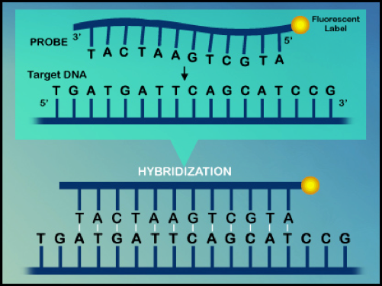

Slide 13
In Situ Hybridization
In Situ Hybridization uses intact DNA molecules within metaphase chromosomes.
The chromosomes are spread on slides and subjected to denaturation and then exposed to a probe labeled with a fluorescence molecule.
The DNA sequence of interest is located on observation with fluorescence.

Slide 14
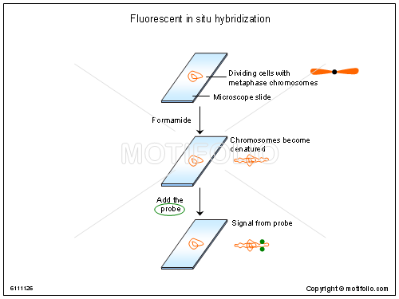

Slide 15
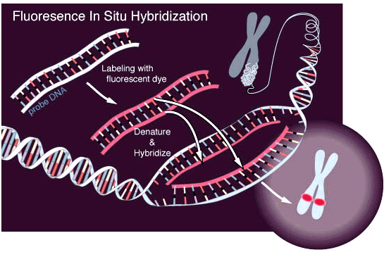

Slide 16
Uses of probes:
(detect specific DNA or RNA sequences):
3 Blotting procedures for detecting a desired gene or other DNA sequence (similar in methodology but differ in molecule detected)
Strand of DNA can hybridize (base-pair) with complementary DNA or RNA
If the DNA contains a label, it can be used as a probe to detect complementary DNA or RNA.

Slide 17
Blotting Techniques
A- Southern Blotting:
Diagnostic technique uses labeled probe with complementary sequence to DNA target
1. Isolation of DNA (extraction)
2. Cutting with restriction enzyme.
3. Separation (agarose gel electrophoresis).
4. Denaturation of DNA within the gel.

Slide 18
5. Blotting of denatured DNA (ssDNA) from gel to a nitrocellulose paper.
6. Hybridization with a specific labeled probe.
7. Only the DNA-probe hybrid appear as an exposed band. It is useful for detection and size determination of specific restriction fragments in a DNA digest.

Slide 19
5. Exposure of nitrocellulose paper to X-ray film to detect the hybrid.
6. Visualisation of bands in the gel by staining with dyes; ethidium bromide; bind to RNA.
7. Fluorescence when exposed to UV light stained DNA or RNA appears reddish orange

Slide 20
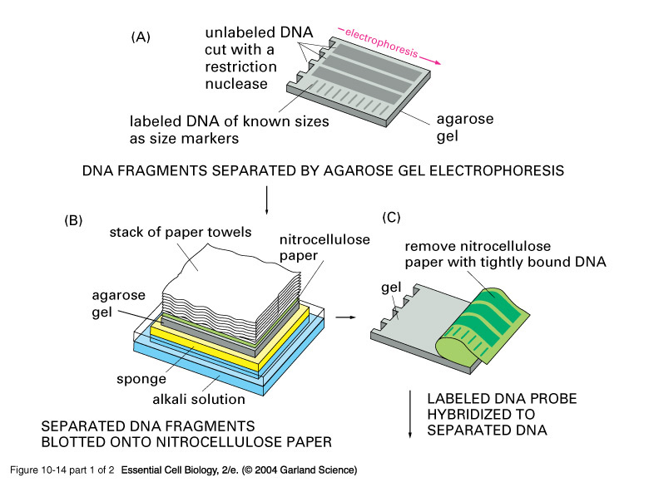

Slide 21
B- Northern Blotting:
Similar to Southern blotting, but detect target RNA using labeled probe with complementary sequence to the target RNA
1. Isolation of RNA
2. Separation by electrophoresis.
3. Blotting to nitrocellulose paper.
4. Hybridization with a specific labeled probe.

Slide 22
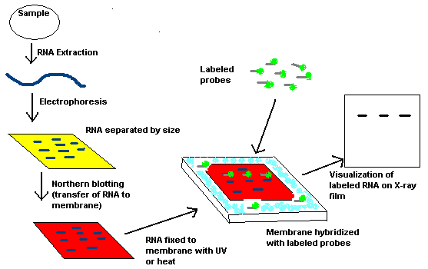

Slide 23
Southern and Northern blotting
DNA
RNA
DNA isolation RNA isolation
Restriction digestion -
Gel electrophoresis √
Denaturtion -
DNA blotting/transfer RNA transfer
Fixation √
6. Probe labeling √
6. Hybridization (temperature) √
7. Signal detection (X-ray film) √

Slide 24
C- Western Blotting:
It is a related teqnique which detects protein by using labeled antibodies to the protein.
The protein is separated by gel electrophoresis.

Slide 25
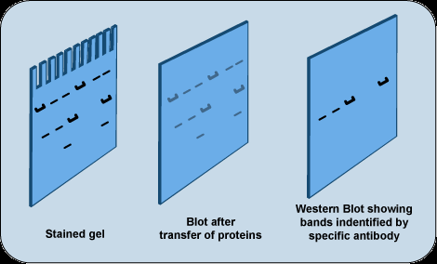

Slide 26

Hybridization techniques
 | Target | Probe | Applications
Southern | DNA | DNA or RNA | Mapping of genes Estimating gene numbers
Northern | RNA | DNA or RNA | RNA sizes, abundance, and expression
Western | Protein | Antibodies | Protein size, abundance

Slide 28
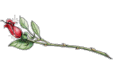

Slide 29



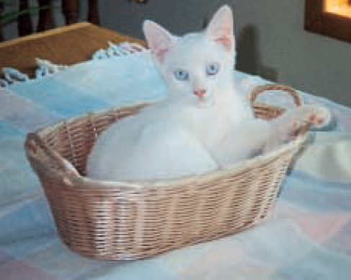
Thank
You

